Slide 1


Modelling and Simulation of Marine Surface Vessel Dynamics (Module 1: Motivation and Overview)
Dr Tristan Perez
Centre for Complex Dynamic Systems and Control (CDSC)
Professor Thor I Fossen
Department of Engineering Cybernetics

Slide 2
Tutorial Goals
Model vessels and environmental loads in 6 DOF.
Use state-of-the-art hydrodynamic codes to compute model parameters: added mass, potential damping, 1st and 2nd-order wave loads.
Derive control plant models by postprocessing data from hydrodynamic codes (Matlab GNC toolbox).
Use system identification to fit hydrodynamic data to state-space models.
Add viscous effects/manoeuvring terms.
Time-domain simulation in Matlab Simulink.

Slide 3
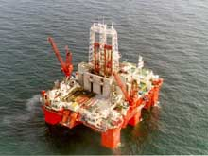
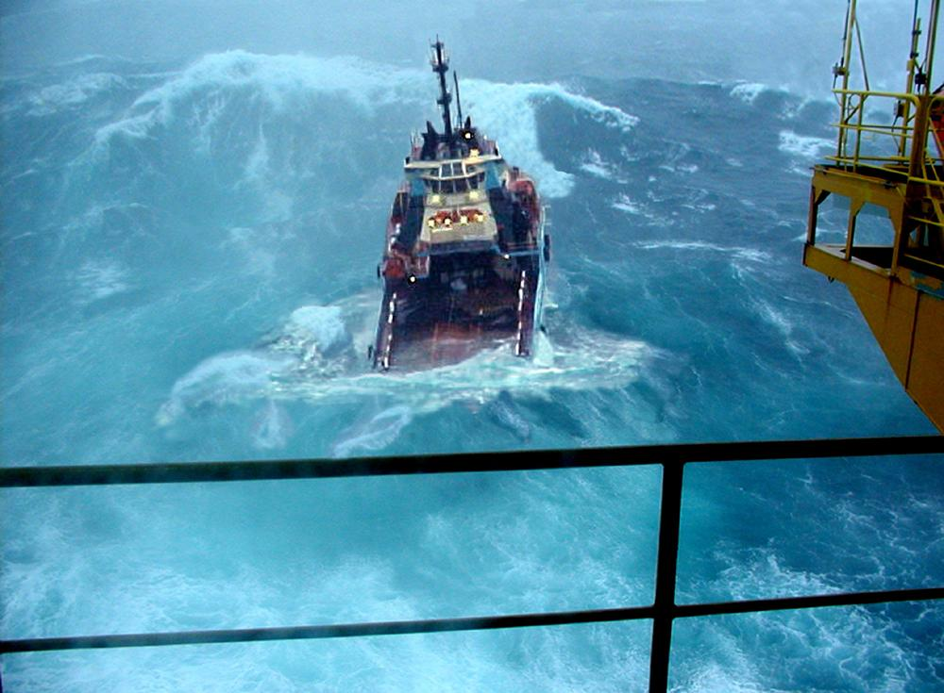
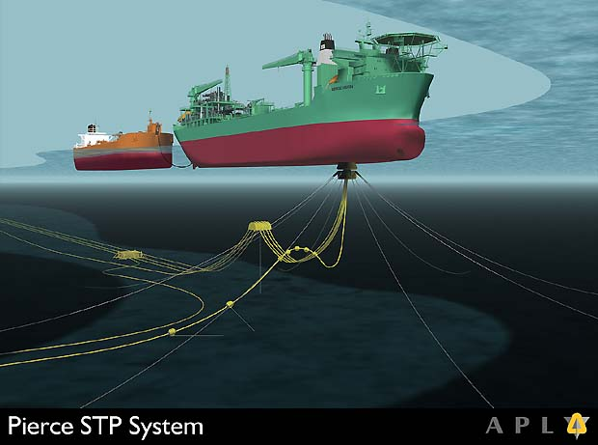
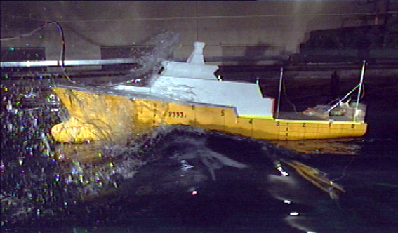
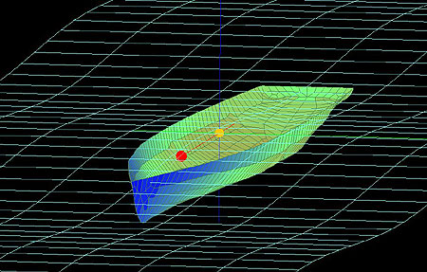
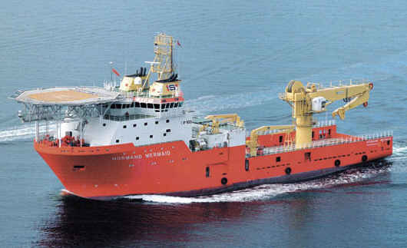
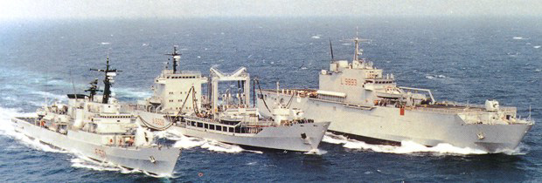
Applications

Slide 4
Modelling and Control
System designers make decisions to satisfy conflicting requirements based on some knowledge of the system they intend to design: this knowledge is represented in a mathematical model.
Modelling is an essential part of control design and preliminary testing, which can consume up to 60% of effort in these tasks.

Slide 5
Modelling of Marine Structures
Models of marine structures are complex.
Control engineers often base their models on models used by naval architects, which sometimes are not control-design oriented.
In this tutorial, we will look at the models commonly used in naval architecture and ship theory from the control system’s perspective.

Slide 6
Obtaining Models
Data-base
Model testing
Scaling
System
Identification
Mathematical
Models
(Simulation,GNC-design
HIL-testing, Diagnosis)
Main focus of this tutorial
System
Identification
System
Identification
Numerical
Hydrodynamics
Full-scale
Experiments

Slide 7
Manoeuvring and Seakeeping
Ship theory has traditionally been separated into two main areas
Manoeuvring The aim is to study steering characteristics of vessels with forward speed and the response to the command of propulsion systems and control surfaces. This is done in calm water. | Sea-keeping The aim is to study the behavior of the vessel in waves while keeping a constant speed and course.
Although both areas are concerned with the study of motion, stability and control, the separation allows one making assumptions that simplify the study in each case.

Slide 8
Manoeuvring Models
Nonlinear parametric models (classical and Lagrangian):
Obtained by fitting data from scaled model experiments.
Calm water models.
Horizontal motion models (surge-sway-yaw).
Not commonly available.
Restricted to a few speeds/loading conditions of the experiment.

Slide 9
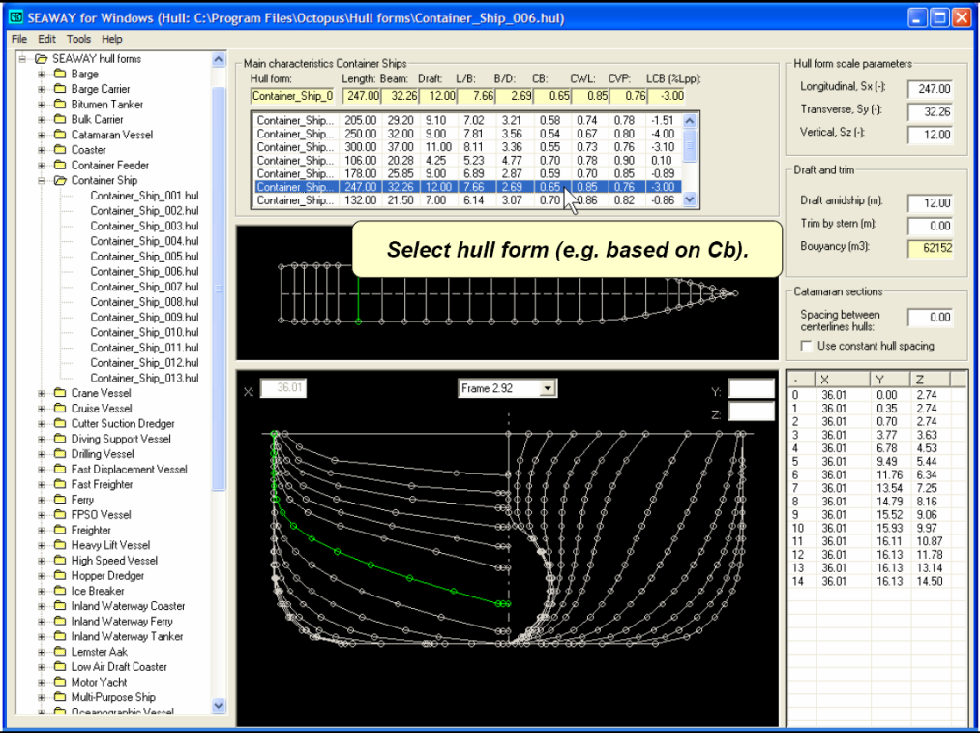
Seakeeping Models
Linear non-parametric models
Obtained from hydrodynamic calculations based on simplifying assumptions:
Constant course and speed.
Linear wave loads.
Potential theory.
Viscous effects can be added.
For the design of control systems, seakeeping models are very useful.
They provide preliminary models based on little data of the ship.

Slide 10
Recent Results on a Unified Manoeuvring and Seakeeping Model
Fossen, T. I. and Ø. N. Smogeli. Nonlinear Time-Domain Strip Theory Formulation for Low-Speed Manoeuvring and Station-Keeping, Modelling, Identification and Control, MIC-25(4):201:221, 2004.
Fossen, T. I. A Nonlinear Unified State-Space Model for Ship Manoeuvring and Control in a Seaway, Journal of Bifurcation and Chaos, September 2005. (Plenary Talk ENOC'05, Eindhoven, The Netherlands).
Perez, T. and T. I. Fossen. Kinematic Models for Sea-keeping and Manoeuvring of Marine Vessels. Modelling, Identification and Control, MIC-28(1):1-12, 2007.
Perez, T. and T. I. Fossen. Time-Domain Models of Marine Surface Vessels for Simulation and Control Design Based on Sea-keeping Computations (Plenary Talk). Proc. of the IFAC MCMC'06, Lisbon, Portugal, September 20-22, 2006.
Ross, A., T. Perez and T. I. Fossen . A Novel Manoeuvring Model Based on Low-Aspect Ratio Lift Theory and Lagrangian Mechanics. Proc. of the IFAC CAMS'07, Croatia.

Slide 11
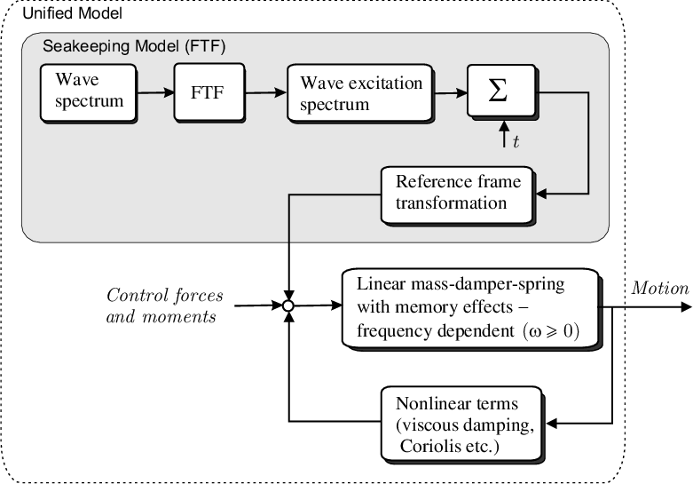
Unified Manoeuvring and Seakeeping Model for Time-Domain Simulation
The Force-Transfer-Functions are computed using hydrodynamic SW (WAMIT, VERES or SEAWAY )
For 6 DOF this model will typically be represented by 6 + 6 + 90 = 102 ODEs
which are computed using
hydrodynamic SW (WAMIT, VERES or SEAWAY )
These terms are found using experimental results/curve fitting or semi-empirical methods

Slide 12
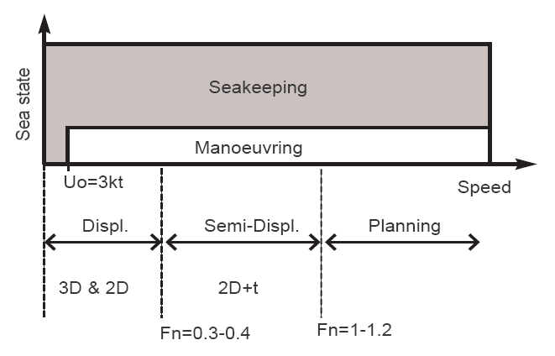
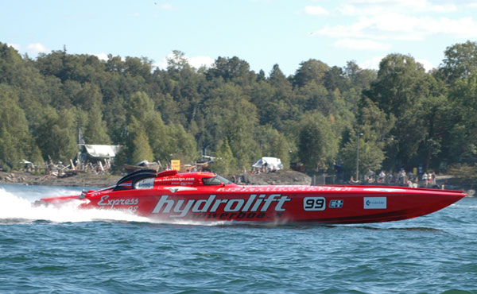
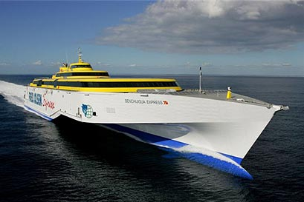
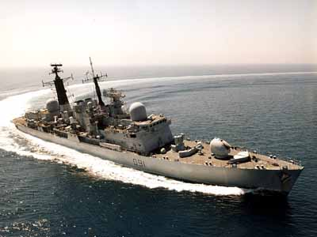
Speed–Environment Envelope
Hull supported by mostly by hydrostatic pressure (forces)
Aero and hydrodynamic forces; strong flow separation
Hydrostatic and hydrodynamic forces; Lift

Slide 13
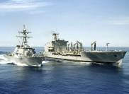
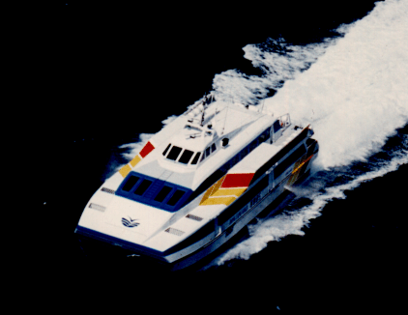
The 3 Speed Regimes for Control
Dynamic positioning systems
3D potential theory
2D potential theory (strip theory)
Manoeuvring/motion damping
2D potential theory (strip theory) up to Froude numbers of 0-3-0.4
2.5 D potential theory for high-speed craft
Low-speed
maneuvering
Manoeuvring at moderate speed
(transit)
Manoeuvring at high speed
(high-speed craft)
Station-keeping
Speed
1.5 m/s (3 knots)
….
…..
0

Slide 14
Motion in Waves
Motions and loads of floating structures due to waves can be separated into
Wave-frequency: linearly excitations and motion in the wave frequency range. Periods in the range 5-20s
Higher than wave frequency (ringing & springing): nonlinear effects, which can produce resonance in TLPs, with natural periods of 2-4s.
Slow and mean drift: nonlinear effects with mean value and sub harmonic excitation that can produce oscillations with natural periods of 20-30s.

Slide 15
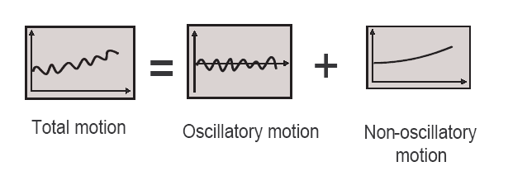
Motion and Control
Then, motion control problems can have different objectives:
Control only the non-oscillatory motion (wave filtering needed)
Autopilots,
Dynamic positioning (DP)
Thruster assisted position mooring (TAPMOOR)
Control only the oscillatory motion
Ride control of high speed vessels (roll and pitch stabilisation)
Heave compensation of offshore structures
Control both
Dynamic positioning in extreme seas (DP + roll & pitch stabilisation)
Autopilots with rudder roll stabilisation
Unmanned Surface Vehicles USV

Slide 16
The Road Ahead
Time | Topic | Presenter
09:00 | M1: Motivation and overview | TIF
09:20 | M2: Hydrodynamics for control engineers | TP
10:00 | M3: Kinematics and kinetic models of marine vessels | TP
10:45 | Coffee break
11:00 | M4: Manoeuvring in calm water | TIF
11:30 | M5: Environmental disturbances | TP
12:00 | Lunch break
13:00 | M6: Motion in waves a frequency-domain approach | TP
13:30 | M7: Motion in waves a time-domain approach | TP
14:00 | M8: Manoeuvring in a seaway | TP
14:30 | M9: Models and marine control problems | TIF
15:00 | M10: Software, and rapid model prototyping | TIF

